Slide 1

WeatherEase
Accessible Weather App for Blind and Visually Impaired Users
Group Members:
Tajra Sinanagic,
Ehab Mohamed,
Mike A. Khadeida.
Supervisor:
Basak Taylan (CUNY Brooklyn College)
Course: CISC 4900
Date: Sept 2025

Slide 2
Mission & Problem Statement
Easy Breezy Forecasts
WeatherEase is designed for blind and visually impaired users, making weather updates simple, fast, and inclusive.
Our mission is clear: to ensure everyone, rain or shine, can access the forecast with ease.
GOAL: By replacing visuals with spoken updates and intuitive voice controls, WeatherEase transforms weather checking into an effortless and empowering experience.

Slide 3

WeatherEase: Purpose, Research, and Learning Path
PURPOSE 🌤️
Hands-free weather via voice commands
Progressive Web App with offline support
Clear, readable forecast cards
Bridges general and accessibility-focused designs
RESEARCH 🔍
Existing apps: Weather Gods, WeatherWheel, Weather for the Blind
Mainly audio output & screen reader support
WeatherEase: UI + voice + offline, general & accessibility-friendly
Coding examples: Stack Overflow, GitHub, Web.dev
FUTURE STUDENT ROADMAP 📚
Weeks 1–2: HTML/CSS basics, explore API
Weeks 3–4: Display weather, basic UI
Weeks 5–6: Text-to-speech (voice output)
Weeks 7–8: Speech recognition (voice input)
Weeks 9–10: Convert to PWA, offline support
Weeks 11–12: Accessibility & UX polish
Week 13: Final deployment, bug fixes
WeatherEase shows how we applied what we’ve learned in class—like working with data structures, arrays, and APIs—to a real-world application.
Our goal was to take a common app and make it more inclusive and accessible, since most student projects rarely focus on accessibility.
This project gave us hands-on experience in building a PWA, integrating voice commands, and designing for all users, while highlighting the value of thoughtful, inclusive coding.

Slide 4
Organization chart
TAJRA – Team Lead
sinanagict@gmail.com
CODING
Repo setup
API
Speech features
LEAD
Creating Weekly Plans
Coordinating tasks
Reviewing progress
EHAB – Individual Contributor
ehabm7986@gmail.com
CODING
UI structure
Error handling
Command mapping
Testing & Debugging
Mutual collaboration in code with Tajra
MIKE – Individual Contributor
mike.khadeida@gmail.com
RESEARCH
Accessibility guidelines
User testing plans
Reporting findings
Supporting UI/UX improvements
Team
ClearPath
BASAK TAYLAN – Supervisor
basak.taylan@brooklyn.cuny.edu

Slide 5

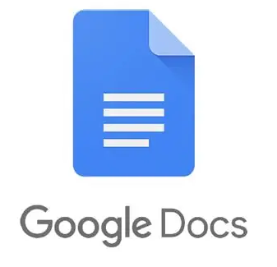

Team collaboration & workflow
COMMUNICATION
Discord, Google Docs, and Notion
Held Discord calls and in-person library meetings (avg. 3 hours per call/meeting) to catch up and plan ahead
🗣️
COLLABORATION
Cross-Collaborated
despite defined roles
Google Docs mirrored Notion but allowed faster access for notes, new tasks, and review markers. 🤝
COORDINATION
Task Management
Assigned tasks based on comfort and adjusted workloads as needed.
Discussed and agreed on task order to balance fairness, and schedule. 🧩
Team
ClearPath
Through open communication, strangers became collaborators, and together we turned our individual strengths into a shared success.

Slide 6
Tentative Schedule – Weeks 3–5 (Approx. 15 hrs/week)
Week | Tajra | Ehab | Mike
3: Sep 8 –14 | repo set up create starter files (index.html, style.css, script.js, manifest.json, service-worker.js) push to GitHub enable Pages basic planning | build HTML layout (<header>, <main>, <footer>) add weather button test keyboard nav minor CSS debug layout | write accessibility guide for blind users share with team review HTML semantic usage
4: Sep 15 – 21 | register OpenWeather API key fetch weather data handle responses debug integration update scripts | display API data on page style temperature/humidity/wind info test keyboard access minor UI fixes | update accessibility checklist with ARIA attributes note progressive enhancement review dynamic content
5: Sep 22 – 28 | implement modular TTS function using SpeechSynthesis API test with sample text debug | connect button to TTS provide visual feedback while reading test keyboard/mouse | suggest concise TTS wording test voice settings guide on reading dynamic info clearly
This schedule shows planned tasks and estimated time per team member for Weeks 3–5, including coding, research, testing, and coordination.

Slide 7
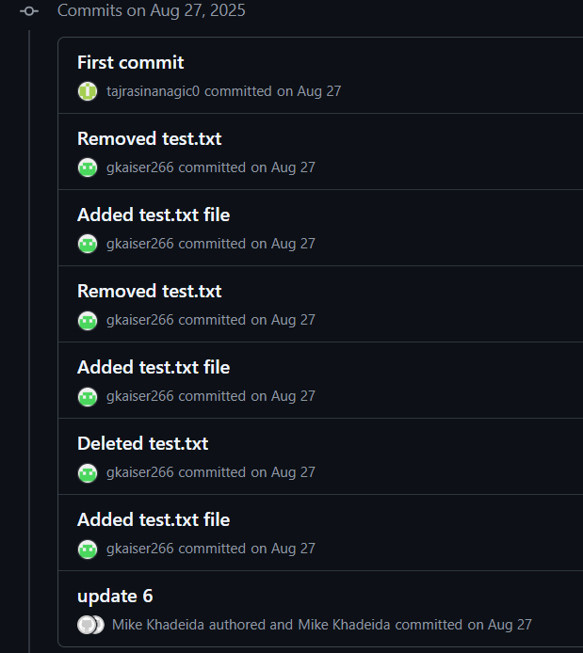
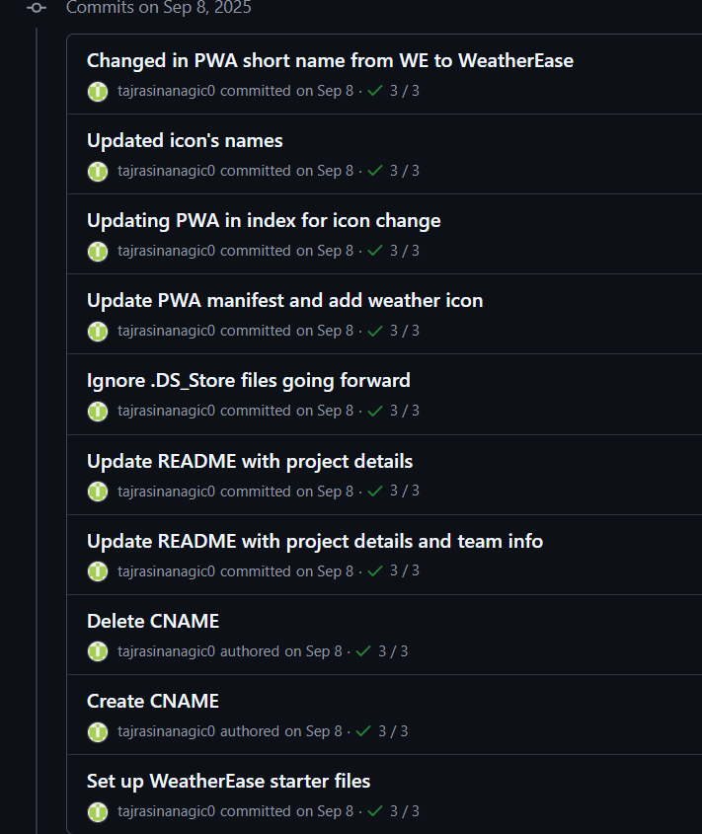
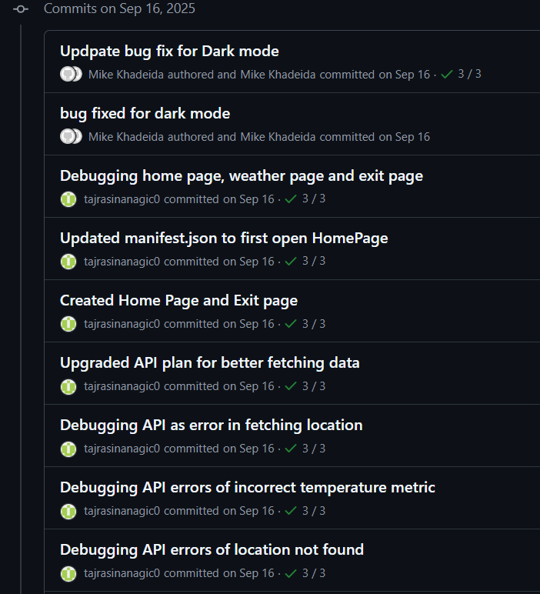
TIMELINE ROADMAP WEEKS 1-3
Commits on Aug 27, 2025 (Week 1)
First meeting:
Figuring out GitHub as collaboration together.
Commits on Sept 8,
(Week I1)
Learning to set up basic pages, working directories, potentially needed files
Commits on Sept 16, (Week II1)
Already implementing API, learning how to debug, adding features we learned in previous courses or from research.
Why these weeks matter?
In just three weeks, our team went from zero to building a working app. Week 1 was all about figuring out GitHub and finding our rhythm. Week 2, we laid the foundation—setting up files, doing research, and planning how to turn ideas into code. By Week 3, we made it real: a progressive web app with live weather data.
These weeks show more than progress—they show how teamwork, open communication, and persistence can turn beginners into a team capable of creating something functional and meaningful.

Slide 8
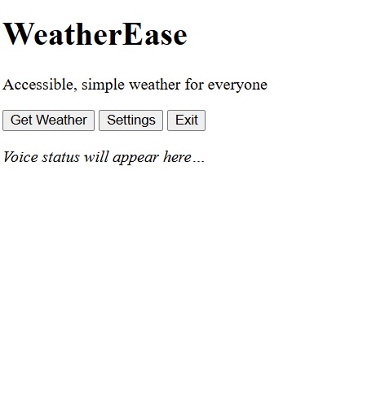
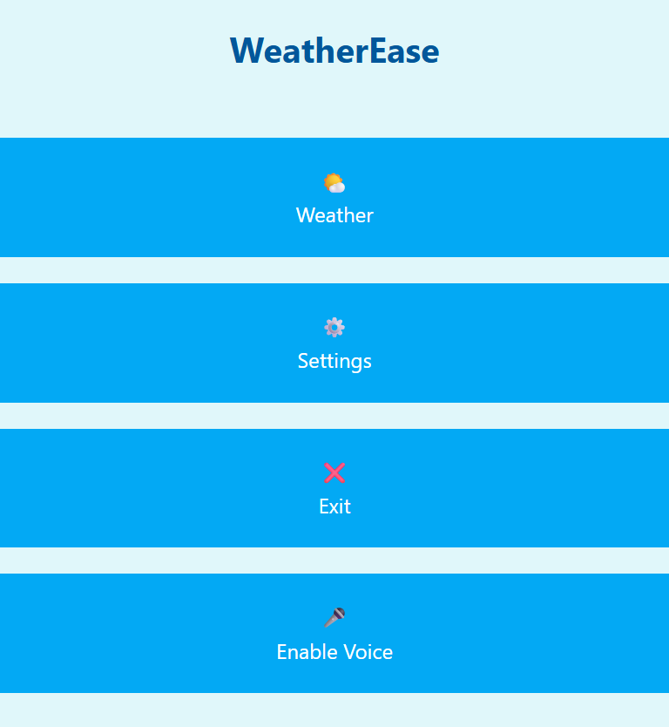
Early Designs – Home Page
Early vs. Current: Started with basic layout and buttons; now improved navigation and responsive design.

Slide 9
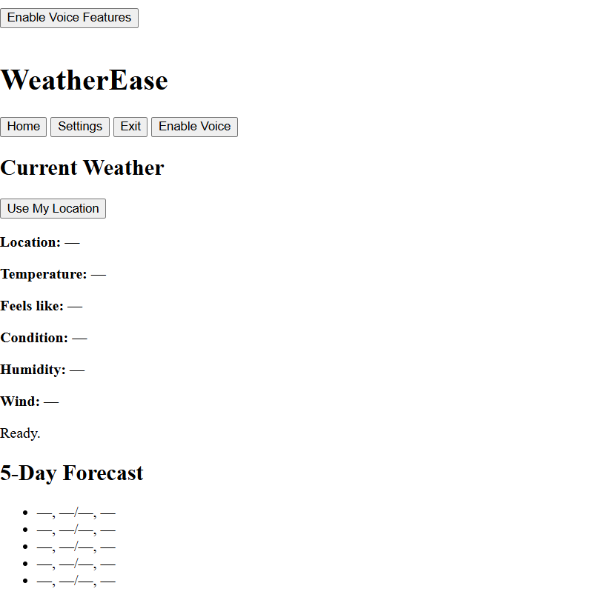
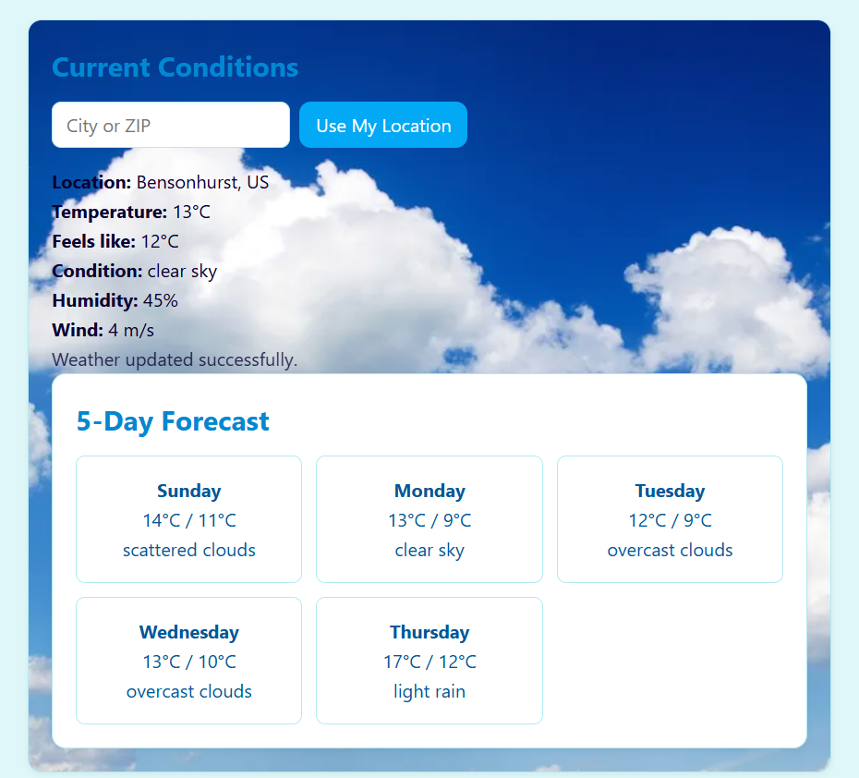
Early Designs – WEATHER
Early vs. Current: From a static design to fully functional weather API integration with interactive search and forecast

Slide 10
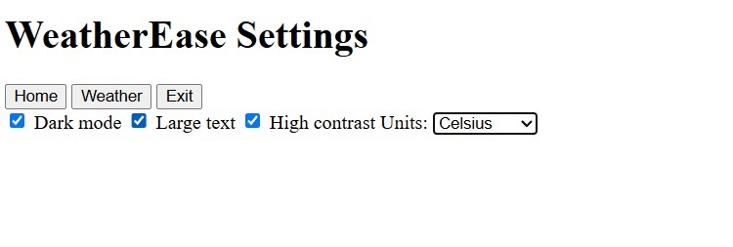
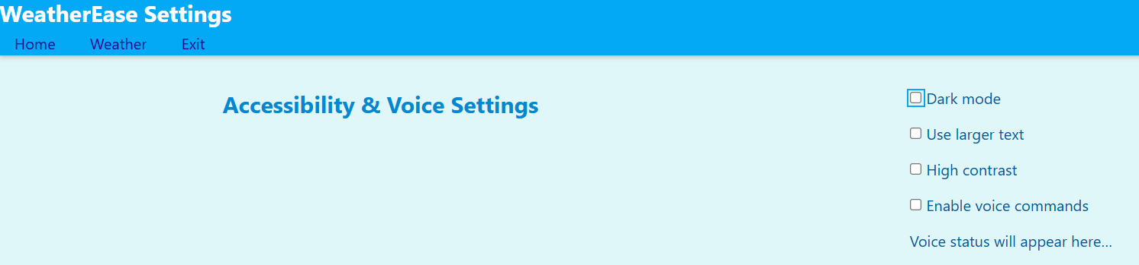
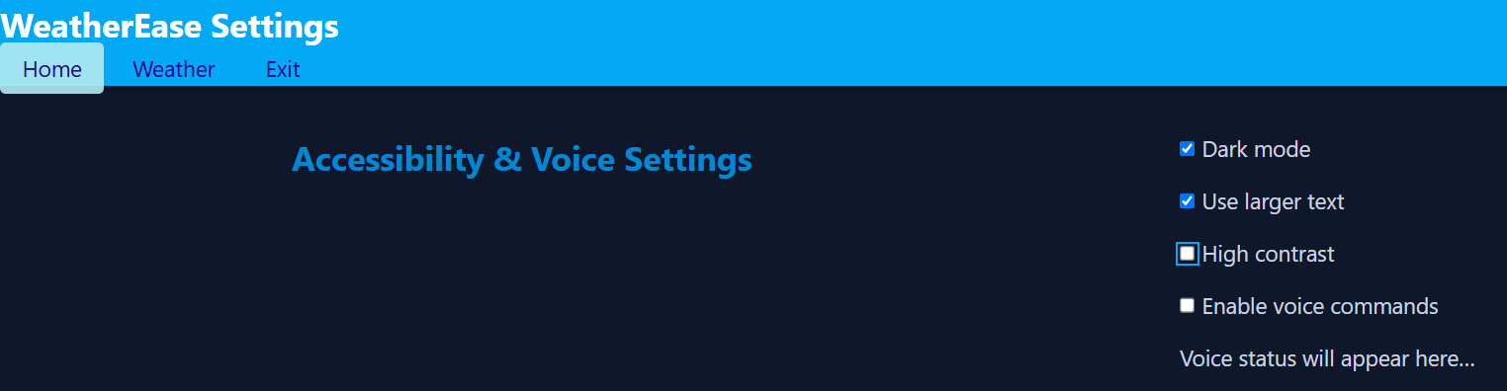
Early Designs – SETTINGS
Early vs. Current: Initial static options evolved into user-friendly settings with functioning dark mode and large text.

Slide 11
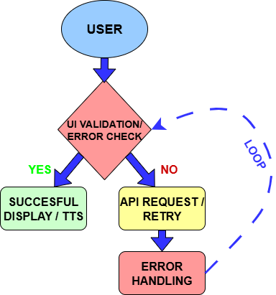
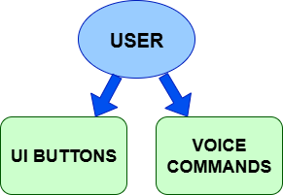
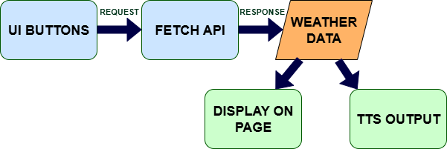
User Input Modalities
Data Flow Diagram
Error Handling Flow
This diagram shows how the user interacts with the app, either by pressing buttons to get weather or listen, or by issuing voice commands for specific information.
This diagram shows how data flows through the app: the user interacts with UI buttons, which trigger API requests. The API retrieves weather data, which is then displayed on the page and read aloud via text-to-speech
This diagram shows how the app handles errors: input is validated, and if successful, data is displayed and read aloud. If validation fails, the API request handles errors and loops back to re-check the input.

Slide 12
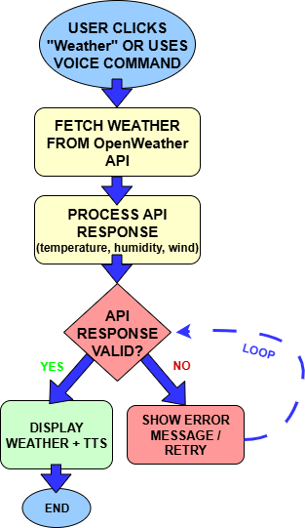
CASE 1: Check Current Weather
In this use case, the user checks the current weather by clicking the 'Get Weather' button or using a voice command.
The app fetches data from the OpenWeatherMap API, processes the temperature, humidity, and wind speed, and displays the results on the screen.
Optionally, the system reads the information aloud using text-to-speech.
If the API response is invalid, an error message is shown, and the system automatically retries the request.

Slide 13
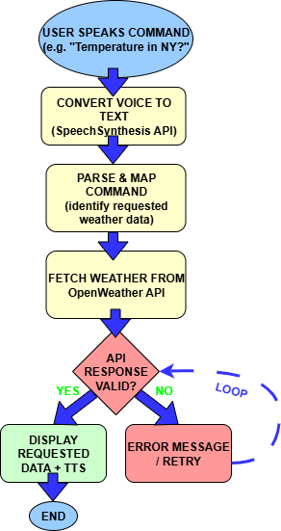
CASE II: Voice Query for Weather Details
In this scenario, the user speaks a command, such as “What’s the temperature in New York?”.
The system first uses the SpeechSynthesis API to convert the spoken input into text, then parses and maps the command to identify the requested weather data.
A call is made to the OpenWeatherMap API, and if the response is valid, the result is displayed on the screen and also read aloud using text-to-speech for convenience.
If the API request fails or the command cannot be understood, the system provides an error message and prompts the user to retry.

Slide 14
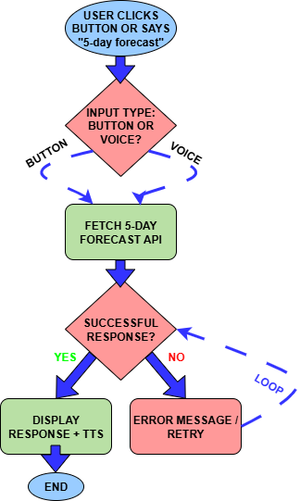
CASE III: Fetching a 5-Day Forecast
In this scenario, the user requests a “5-day weather forecast.”
The system calls the OpenWeatherMap Forecast API and retrieves hourly and daily forecast data for the next five days.
The information is displayed in a clean format on the screen (such as date, temperature, humidity, and conditions).
At the same time, a summary of each day’s weather is read aloud using text-to-speech for accessibility.
If the API call fails, the user is shown an error message with the option to retry.

Slide 15
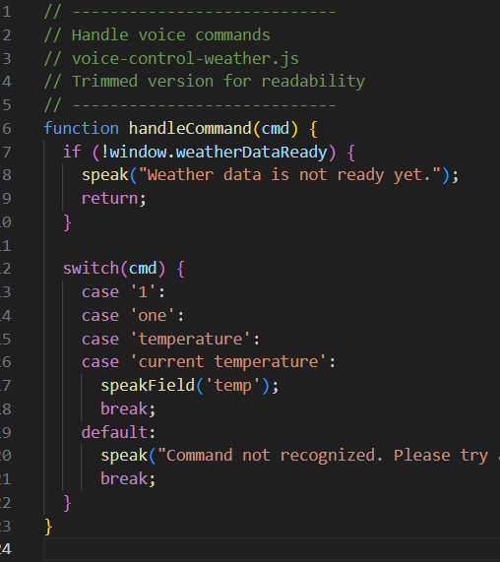
CODE HIGHLIGHT – VOICE COMMAND BUG
Prevents user voice commands from running before weather data loads.
BUG – What was the problem?
Users could trigger voice commands before the weather API returned data.
The app would try to speak temperature or weather conditions that didn’t exist yet, resulting in empty or wrong output.
FIX – Solution to the problem
Added a check for window.weatherDataReady at the start of handleCommand.
If the data isn’t ready, the app notifies the user and exits early.
This ensures voice commands only respond once valid weather info is available

Slide 16

Data Source: OpenWeatherMap API
DATASET NATURE
Provides current weather and forecasts (hourly up to 4 days, daily up to 16 days).
Includes historical data and statistical weather parameters.
Offers weather maps with multiple layers and air pollution data.
Accessible via geocoding API for location-based queries.
Responses are structured in JSON format and updated in real-time.
API usage limits: 3,000 calls/minute, 100 million calls/month for current/forecast data; 50,000 calls/day for historical data.

Slide 17

Tools & Technologies
LANGUAGES
HTML5
CSS3
JavaScript
API
OpenWeatherMap
Web Speech API
SpeechSynthesis API
PWA COMPONENTS
manifest.json (app metadata & install behavior)
Service Worker (offline caching)
HOSTING
GitHub
GitHub Pages
PROJECT MANAGEMENT
Notion
Google Docs
DEVICE TESTING
Chrome
Microsoft Edge
Safari (iOS)
Android browsers (Google Play devices)

Slide 18


LINKS
MUST
DOWNLOAD!
GITHUB: https://github.com/Project4900
PROJECT MANAGEMENT BOARD: WeatherEase | Kanban
GOOGLE DOCS: https://docs.google.com/document/d/1IGvmm2wwOGerVoRkflSTbxjR2IwU7Bl5_7Lgd7Z1JMg/edit?usp=sharing
WEBSITE: WeatherEase

